Slide 1
Chapter 3
The Internal Organization: Resources, Capabilities, Core Competencies, and Competitive Advantages

Slide 2
Competitive Advantage
Firms achieve strategic competitiveness and earn above-average returns when their core competencies are effectively:
  acquired
  bundled
  leveraged
Over time, the benefits of any value-creating strategy can be duplicated by competitors.

Slide 3
Competitive Advantage (cont’d)
Sustainability of a competitive advantage is a function of the:
  rate of core competence obsolescence because of environmental changes.
  availability of substitutes for the core competence.
  imitability of the core competence.

Slide 4
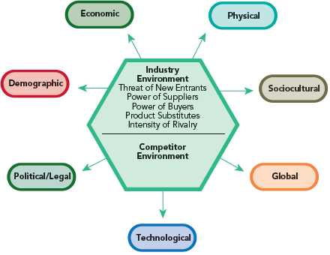
Analyzing the External Environment
Opportunities and threats
By studying the external environment, firms identify what they might choose to do.

Slide 5

Analyzing the Internal Organization
Unique resources, capabilities, and competencies
(required for sustainable competitive advantage)
By studying the internal environment, firms identify what they can do.

Slide 6
The Context of Internal Analysis
Global Economy
  Traditional sources of advantages can be overcome by competitors’ international strategies and by the flow of resources throughout the global economy.
Global Mind-Set
  The ability to study an internal environment in ways that are not dependent on the assumptions of a single country, culture, or context.
Analysis Outcome
  Understanding how to leverage the firm’s bundle of heterogeneous resources and capabilities.

Slide 7
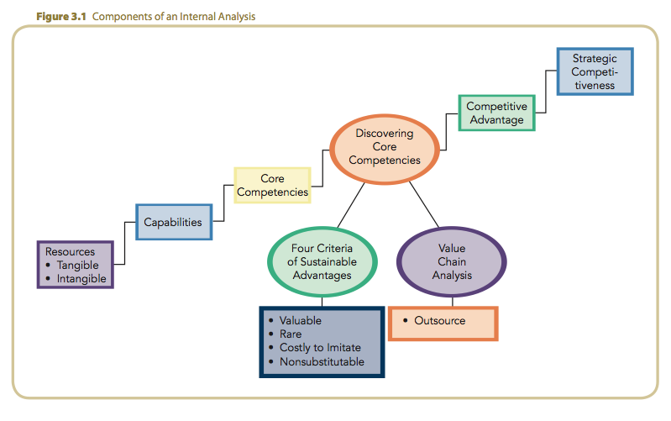
Components of an Internal Analysis

Slide 8
Creating Value
By exploiting their core competencies or competitive advantages, firms create value.
Value is measured by:
  product performance characteristics.
  product attributes for which customers will pay.
Firms create value by innovatively bundling and leveraging their resources and capabilities.
Superior value leads to above-average returns.

Slide 9
Creating Competitive Advantage
Core competencies, in combination with product-market positions, are the firm’s most important sources of competitive advantage.
Core competencies of a firm, in addition to the analysis of its general, industry, and competitor environments, should drive its selection of strategies.

Slide 10
The Challenge of Analyzing the Internal Organization
Strategic decisions in terms of the firm’s resources, capabilities, and core competencies:
  are non-routine.
  have ethical implications.
  significantly influence the firm’s ability to earn above-average returns.

Slide 11
The Challenge of Analyzing the Internal Organization (cont’d)
When making strategic decisions, managers as strategic leaders must:
  know when a capability is not a competence.
  learn quickly from failures and mistakes.
  have the maturity of judgment to deal effectively with uncertainty, complexity, and intra-organizational conflicts in an unbiased manner.
  be willing to take intelligent risks.

Slide 12
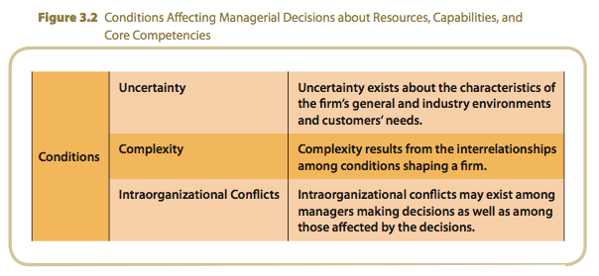
Conditions Affecting Managerial Decisions

Slide 13
Resources, Capabilities, and Core Competencies
Resources:
  are the source of a firm’s capabilities.
  are broad in scope.
  cover a spectrum of individual, social and organizational phenomena.
  alone, do not yield a competitive advantage.
Competitive
Advantage
Core
Competencies
Capabilities
Resources
Tangible
Intangible

Slide 14
Resources
Resources
  A firm’s assets, including people and the value of its brand name, that represent inputs into a firm’s production process:
    capital equipment
    skills of employees
    brand names
    financial resources
    talented managers
Types of Resources
  Tangible resources:
    financial
    physical
    technological
    organizational
  Intangible resources:
    human
    innovation
    reputation

Slide 15
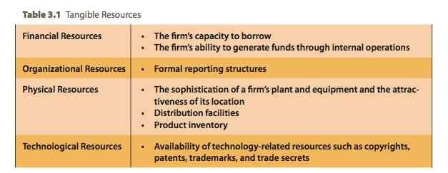
Tangible Resources

Slide 16
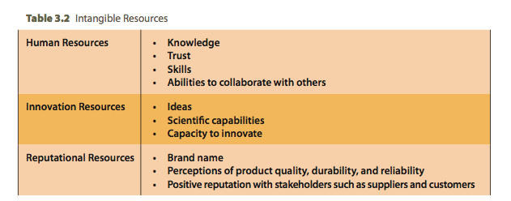
Intangible Resources

Slide 17
Resources, Capabilities and Core Competencies
Capabilities:
represent the capacity to deploy resources that have been purposely integrated to achieve a desired end state.
emerge over time through complex interactions among tangible and intangible resources.
Competitive
Advantage
Core
Competencies
Capabilities
Resources
Tangible
Intangible

Slide 18
Resources, Capabilities and Core Competencies
Capabilities (cont’d):
often are based on developing, carrying and exchanging information and knowledge through the firm’s human capital.
composed of the unique skills and knowledge of a firm’s employees.
include functional expertise of employees.
often developed in specific functional areas or as part of a functional area.
Competitive
Advantage
Core
Competencies
Capabilities
Resources
Tangible
Intangible

Slide 19
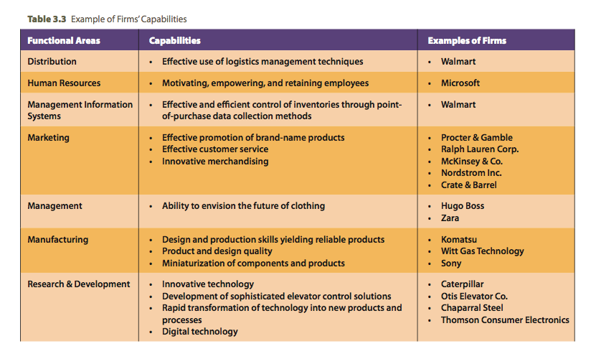
Example of Firms’ Capabilities

Slide 20
Resources, Capabilities and Core Competencies
The four criteria for determining strategic capabilities:
value
rarity
costly-to-imitate
non-substitutability
Competitive
Advantage
Core
Competencies
Capabilities
Resources
Tangible
Intangible

Slide 21
Resources, Capabilities and Core Competencies
Core Competencies
Resources and capabilities that are the sources of a firm’s competitive advantage that:
  distinguish a firm competitively and reflect its personality.
  emerge over time through an organizational process of accumulating and learning how to deploy different resources and capabilities.
Competitive
Advantage
Core
Competencies
Capabilities
Resources
Tangible
Intangible

Slide 22
Resources, Capabilities and Core Competencies
Core Competencies (cont’d):
activities that a firm performs especially well compared to competitors.
activities through which the firm adds unique value to its goods or services over a long period of time.
Competitive
Advantage
Core
Competencies
Capabilities
Resources
Tangible
Intangible

Slide 23
Building Core Competencies
The four criteria of sustainable competitive advantages:
valuable capabilities
rare capabilities
costly to imitate
non-substitutable
Sustainable
Competitive
Advantage
Four Criteria of
Sustainable
Advantages
Valuable
Rare
Costly to imitate
Nonsubstitutable

Slide 24
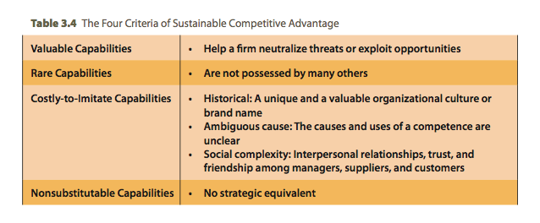
The Four Criteria of Sustainable Advantage

Slide 25
Building Sustainable Competitive Advantage
Valuable capabilities:
  help a firm neutralize threats or exploit opportunities.
Rare capabilities
  are not possessed by many others.
Sustainable
Competitive
Advantage
Four Criteria of
Sustainable
Advantages
Valuable
Rare
Costly to imitate
Non-substitutable

Slide 26
Building Sustainable Competitive Advantage
Costly-to-Imitate Capabilities
  Historical
    A unique and a valuable organizational culture or brand name
  Ambiguous cause
    The causes and uses of a competence are unclear
  Social complexity
    Interpersonal relationships, trust, and friendship among managers, suppliers, and customers
Sustainable
Competitive
Advantage
Four Criteria of
Sustainable
Advantages
Valuable
Rare
Costly to imitate
Non-substitutable

Slide 27
Building Sustainable Competitive Advantage
Non-substitutable Capabilities
  No strategic equivalent
    firm-specific knowledge
    organizational culture
    superior execution of the chosen business model
Sustainable
Competitive
Advantage
Four Criteria of
Sustainable
Advantages
Valuable
Rare
Costly to imitate
Non-substitutable

Slide 28
Outcomes from Combinations of the Four Criteria
Costly to Imitate?
Nonsubstitutable?
Valuable?
Competitive
Consequences
Performance
Implications
Rare?
No
No
No
No
Competitive
Disadvantage
Below Average
Returns
Yes
No
No
Yes/
No
Competitive
Parity
Average Returns
Yes
Yes
No
Yes/
No
Temporary Com-
petitive Advantage
Above Average to
Average Returns
Yes
Yes
Yes
Yes
Sustainable Com-
petitive Advantage
Above Average
Returns

Slide 29
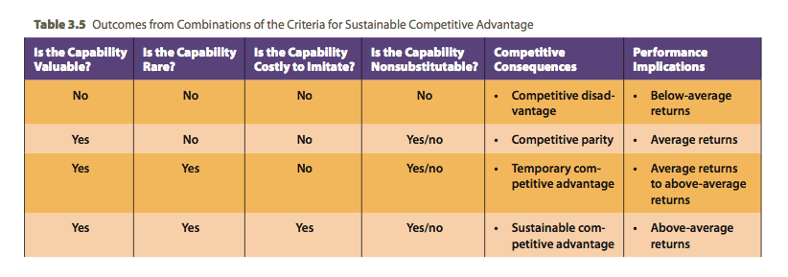
Criteria for Sustainable Advantage

Slide 30
Value Chain Analysis
Value Chain Analysis:
  allows a firm to understand the parts of its operations that create value and those that do not.
  is a template that firms use to:
    understand their cost position.
    identify multiple means that might be used to facilitate implementation of a chosen business-level strategy.

Slide 31
Value Chain Analysis (cont’d)
Primary Activities:
  are involved with:
    a product’s physical creation.
    a product’s sale and distribution to buyers.
    the product’s service after the sale.
Support Activities:
  provide the assistance necessary for the primary activities to take place.

Slide 32
Value Chain Analysis (cont’d)
Value Chain shows how a product moves from the raw-material stage to the final customer.
To be a source of competitive advantage, a resource or capability must allow the firm to perform:
  an activity in a manner that is superior to the way competitors perform it, or
  a value-creating activity that competitors cannot complete

Slide 33
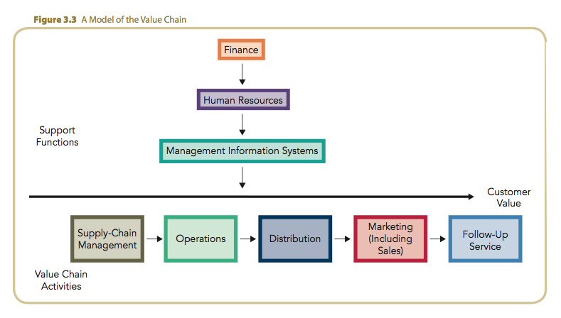
A Model of the Value Chain

Slide 34
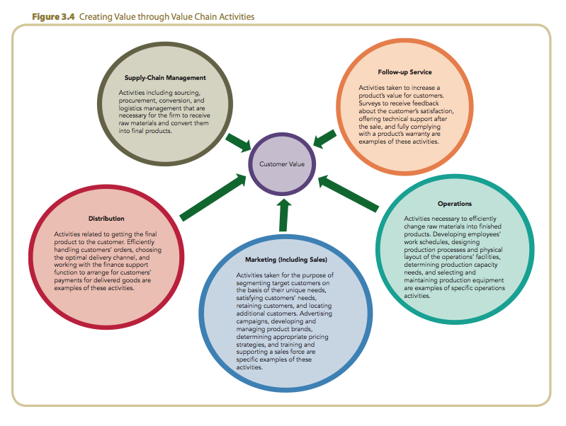
Creating Value through Value Chain Activities

Slide 35
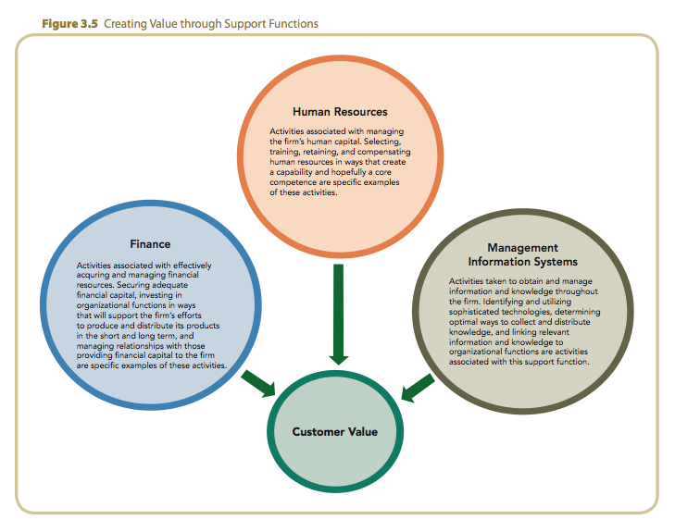
Creating Value through Support Functions

Slide 36
The Value-Creating Potential of Primary Activities
Inbound Logistics
  Activities used to receive, store, and disseminate inputs to a product.
Operations
  Activities necessary to convert the inputs provided by inbound logistics into final product form.
Outbound Logistics
  Activities involved with collecting, storing, and physically distributing the product to customers.

Slide 37
The Value-Creating Potential of Primary Activities (cont’d)
Marketing and Sales
  Activities completed to provide the means through which customers can purchase products and to induce them to do so.
Service
  Activities designed to enhance or maintain a product’s value.
Each activity should be examined relative to competitor’s abilities and rated as superior, equivalent or inferior.

Slide 38
The Value-Creating Potential of Primary Activities: Support
Procurement
  Activities completed to purchase the inputs needed to produce a firm’s products.
Technological Development
  Activities completed to improve a firm’s product and the processes used to manufacture it.
Human Resource Management
  Activities involved with recruiting, hiring, training, developing, and compensating all personnel.

Slide 39
The Value-Creating Potential of
Primary Activities: Support (cont’d)
Firm Infrastructure
  Activities that support the work of the entire value chain (general management, planning, finance, accounting, legal, government relations, etc.).
    Effectively and consistently identify external opportunities and threats
    Identify resources and capabilities
    Support core competencies
Each activity should be examined relative to competitor’s abilities and rated as superior, equivalent or inferior.

Slide 40
Outsourcing
Outsourcing is the purchase of a value-creating activity from an external supplier.
Few organizations possess the resources and capabilities required to achieve competitive superiority in all primary and support activities.
By performing fewer capabilities:
  a firm can concentrate on those areas in which it can create value.
  specialty suppliers can perform outsourced capabilities more efficiently.

